Slide 1

Landau levels and their degeneracy
By:
Dharamananda Saha
CUSB2404112015

Slide 2
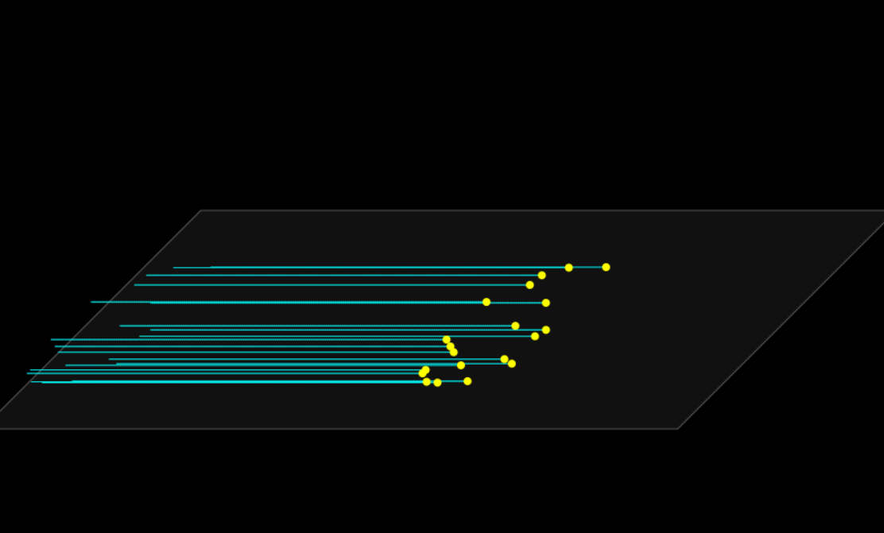
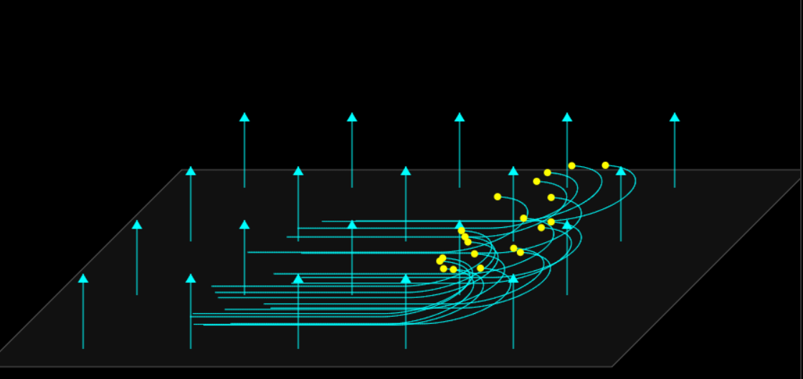
OVERVIEW
B=0
B>0
https://github.com/dharamasaha015-cmd/QHE

Slide 3
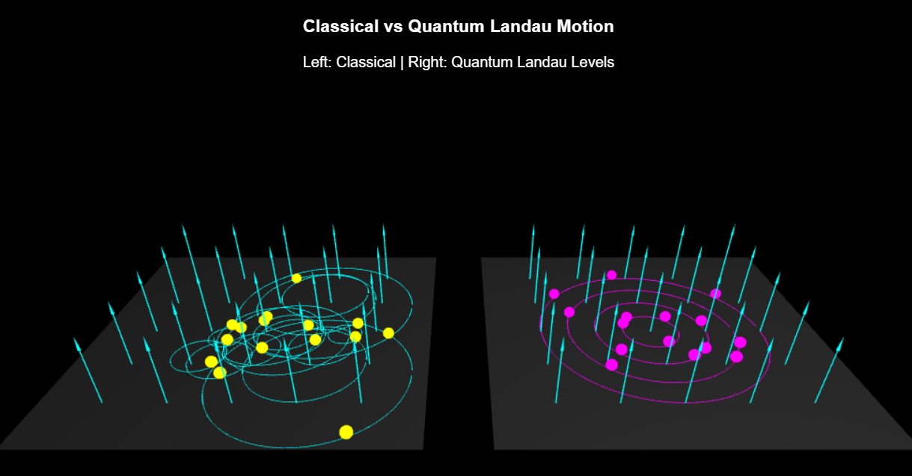
OVERVIEW
https://github.com/dharamasaha015-cmd/QHE

Slide 4
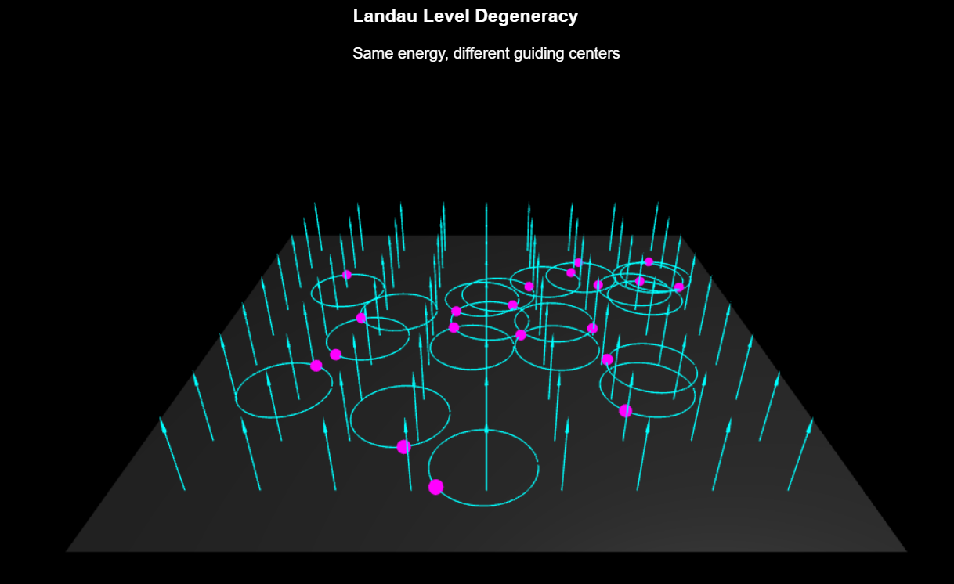
OVERVIEW
https://github.com/dharamasaha015-cmd/QHE

Slide 5
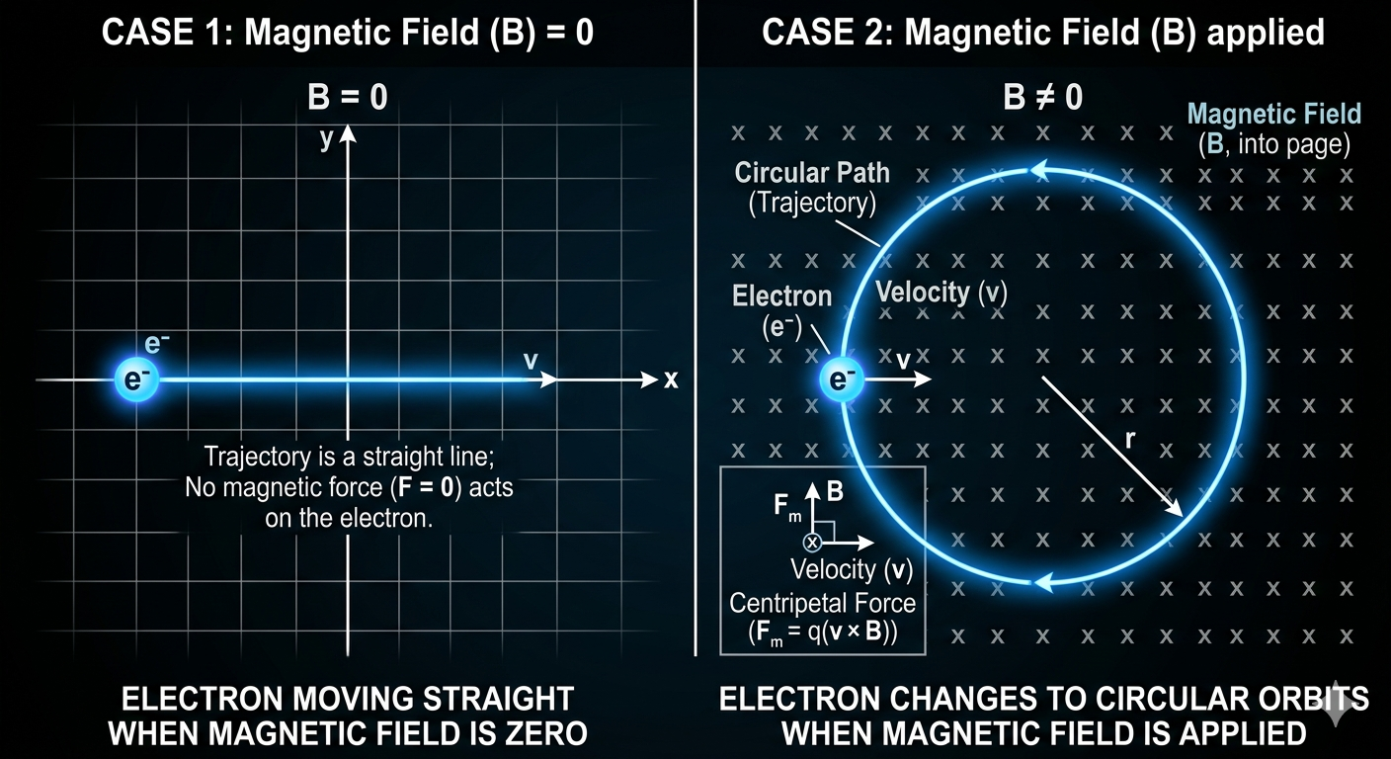
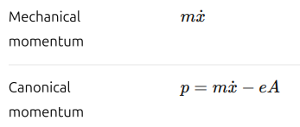

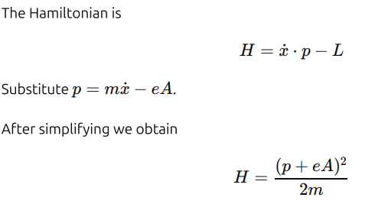
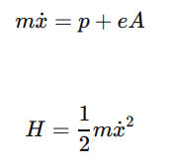



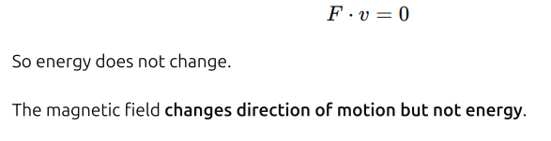
LANDAU LEVELS
This is just the kinetic energy=
This is just the kinetic energy=
The lagrangian for a electron moving in magnetic field is given by
This is just the
kinetic energy
This term represents the interaction between the charged particle and the magnetic field.
Momentum is defined from the Lagrangian as:-
=>
dhttp://www.damtp.cam.ac.uk/user/tong/qhe/qhe.pdf

Slide 6
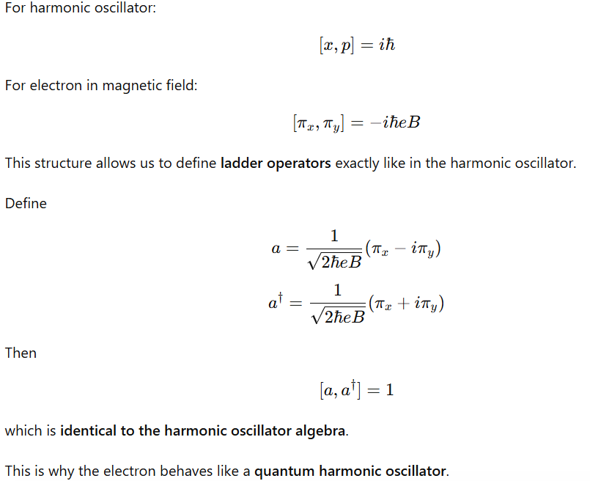
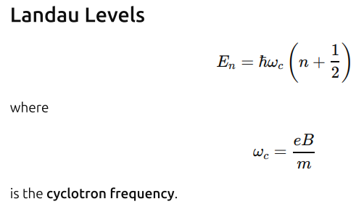
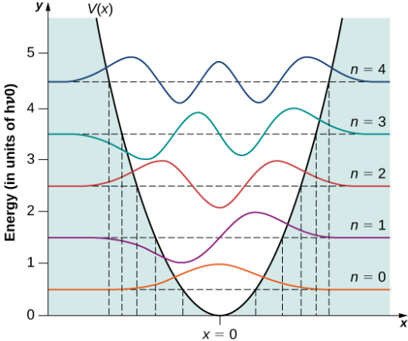
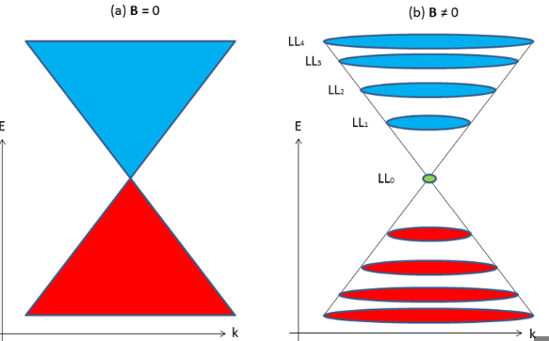
LANDAU LEVELS
https://www.researchgate.net/publication/282665999/figure/fig10/AS:668581947785233@1536413766563/Landau-Levels-of-Graphene-a-When-a-magnetic-field-is-not-applied-the-valence-band.ppm
dhttp://www.damtp.cam.ac.uk/user/tong/qhe/qhe.pdf

Slide 7
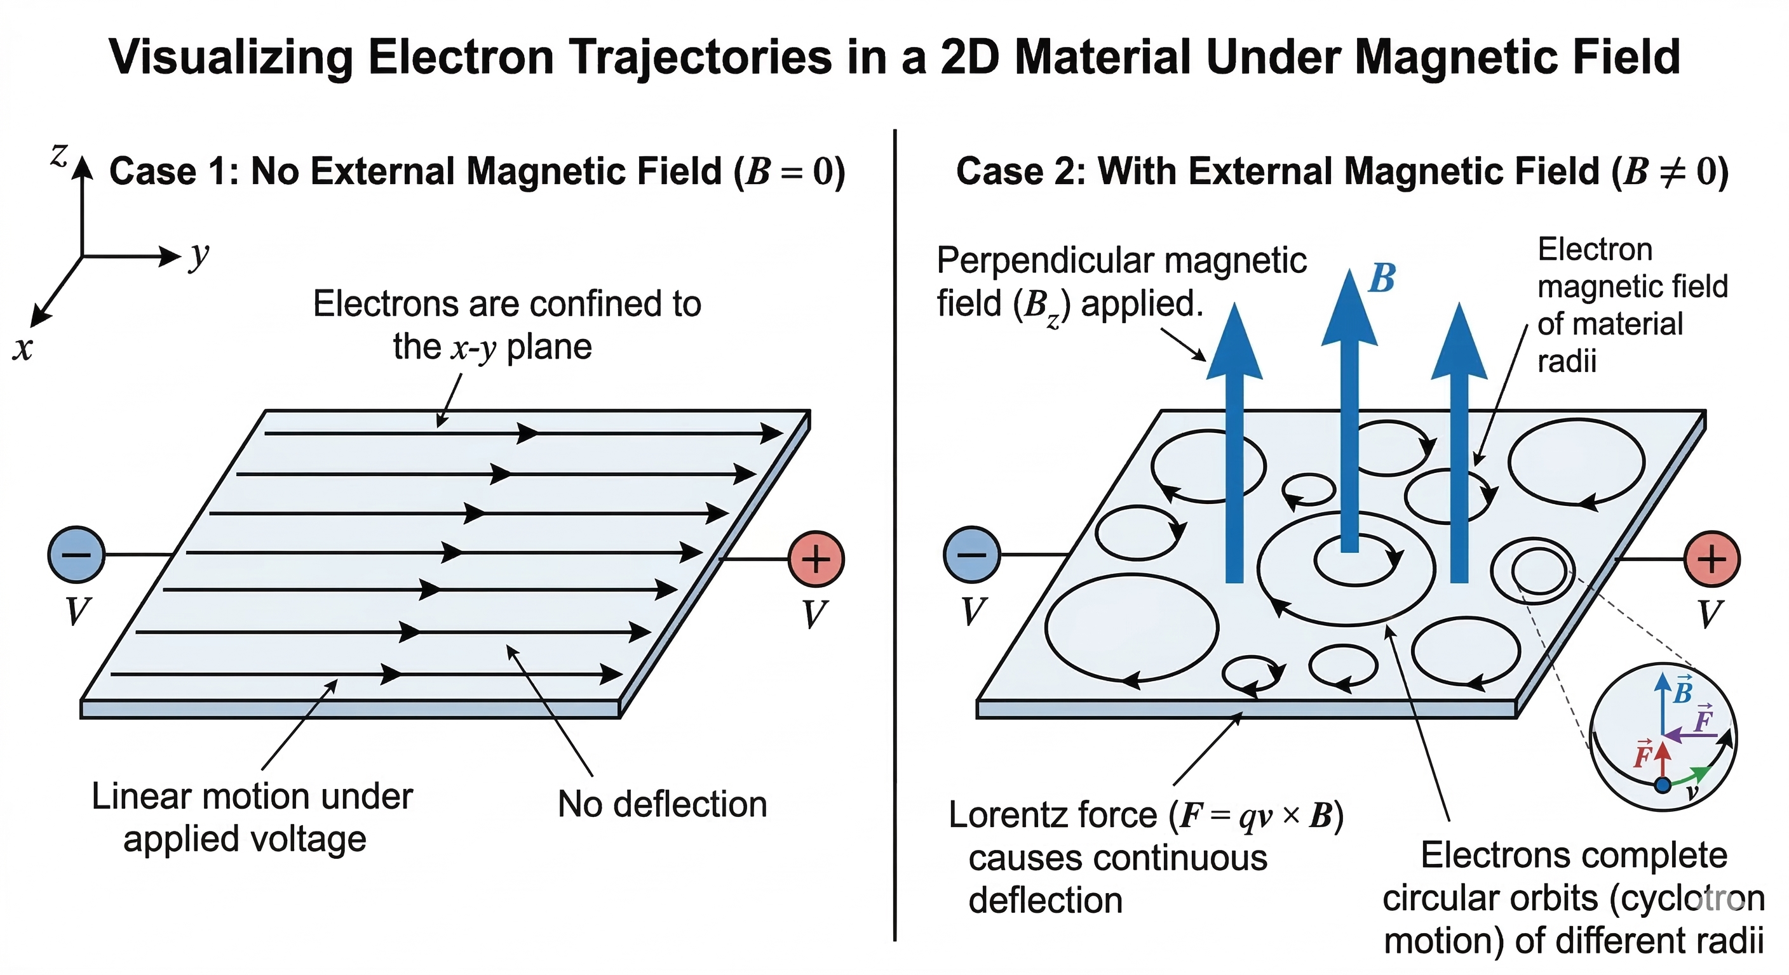
LANDAU LEVELS and their Degeneracy
dhttp://www.damtp.cam.ac.uk/user/tong/qhe/qhe.pdf

Slide 8
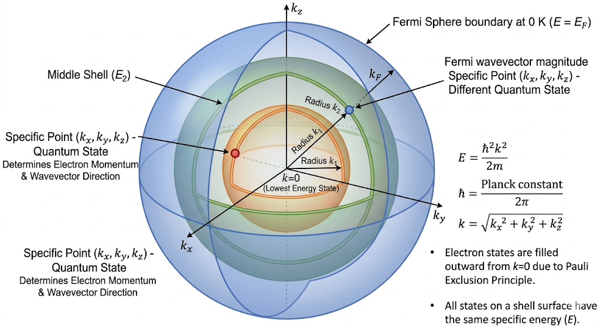
Formation of the LANDAU TUBES
dhttp://www.damtp.cam.ac.uk/user/tong/qhe/qhe.pdf

Slide 9
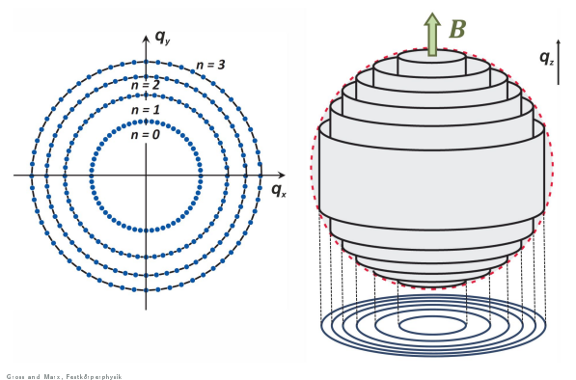
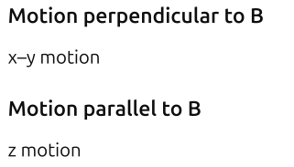
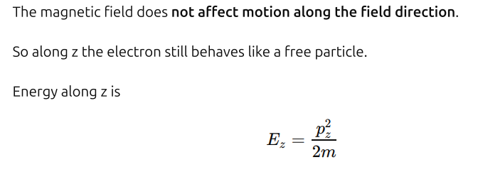
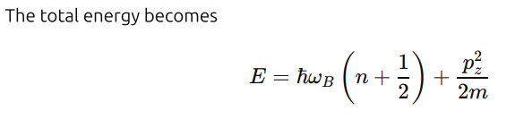
Formation of the LANDAU TUBES
When B is applied :
https://encrypted-tbn0.gstatic.com/images?q=tbn:ANd9GcTIWU7ObNXu1HaBf7gJ5wTctLDxp_LCdlSKzw&s
dhttp://www.damtp.cam.ac.uk/user/tong/qhe/qhe.pdf

Slide 10
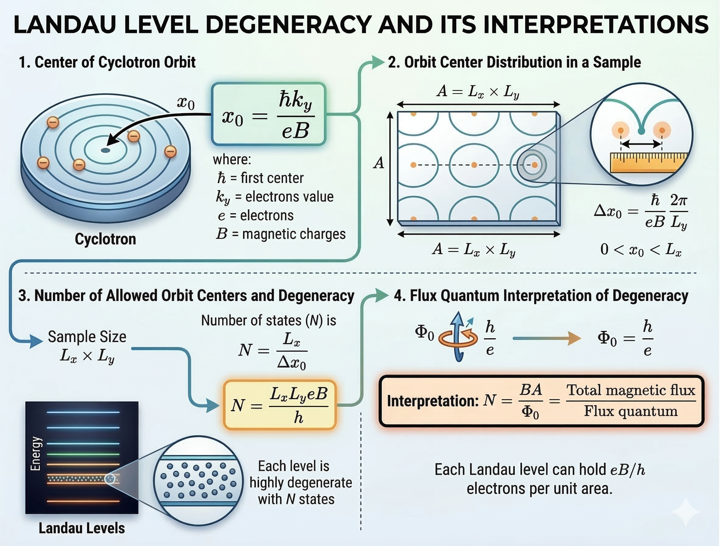

Degeneracies
Xo is the centre of the cyclotron orbit.
dhttp://www.damtp.cam.ac.uk/user/tong/qhe/qhe.pdf

Slide 11
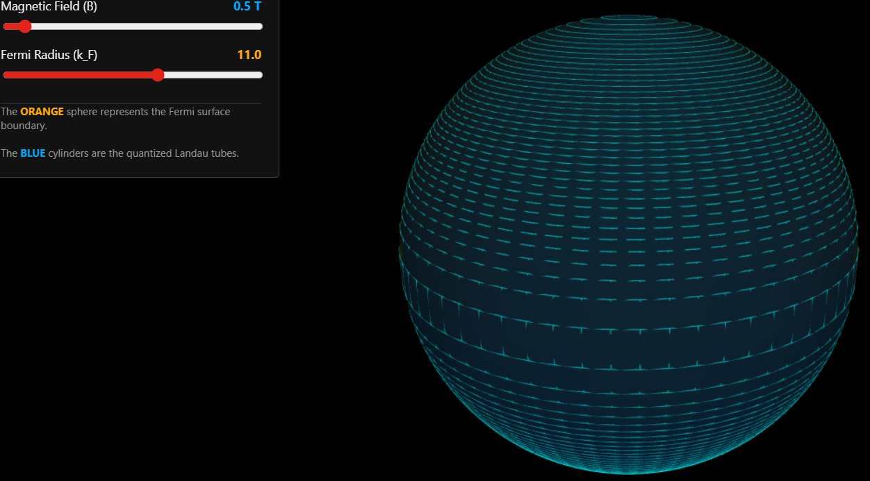
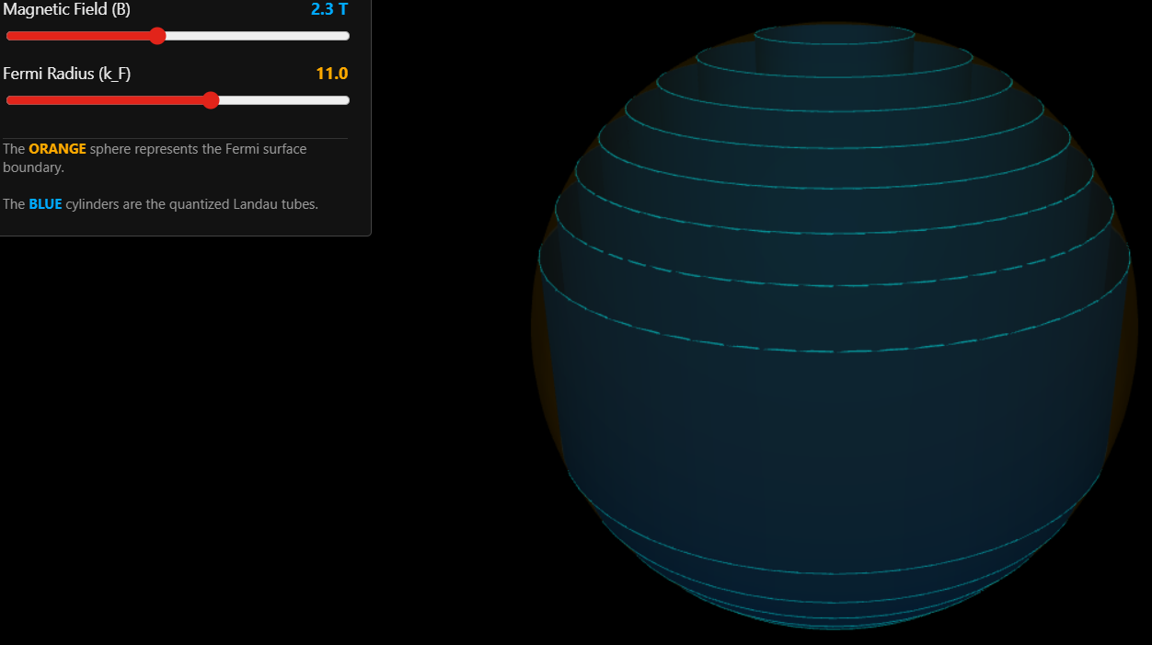
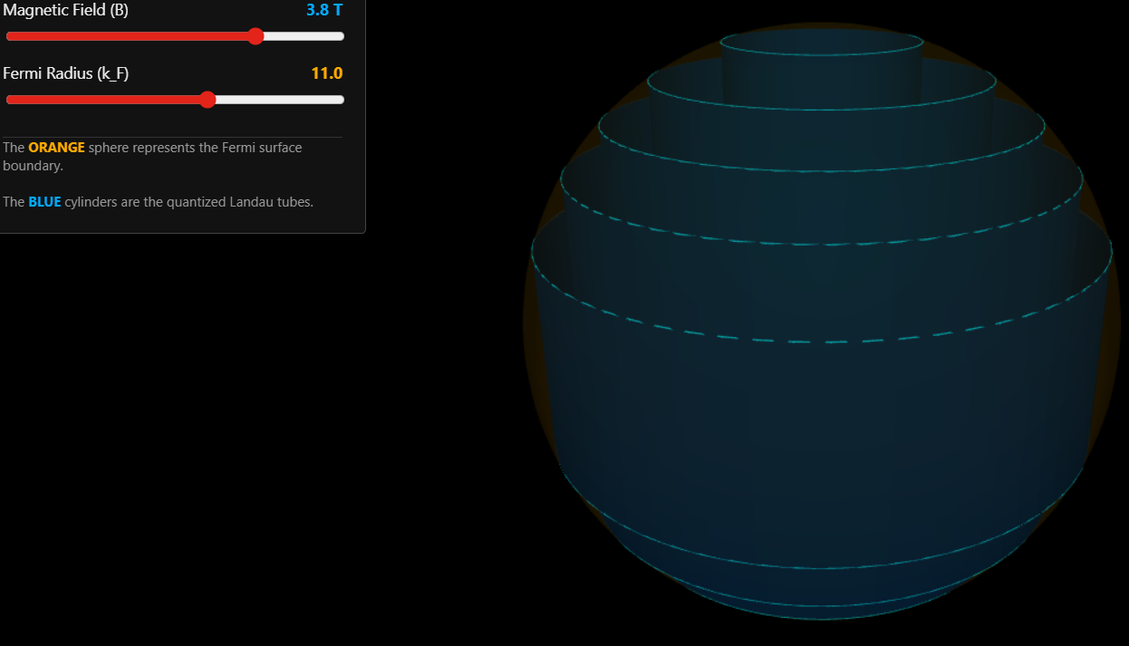
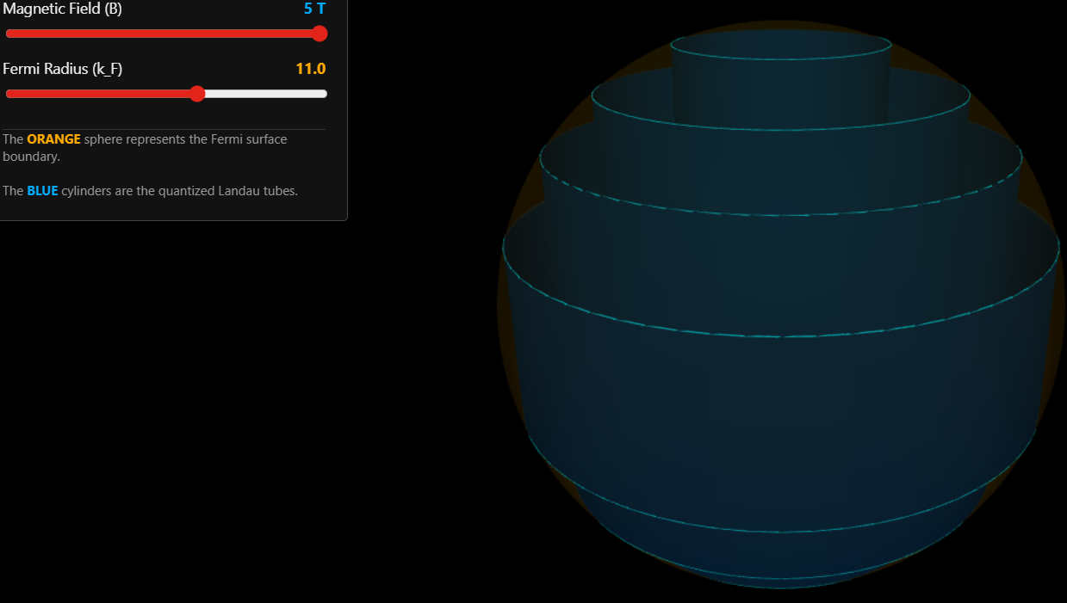

Slide 12
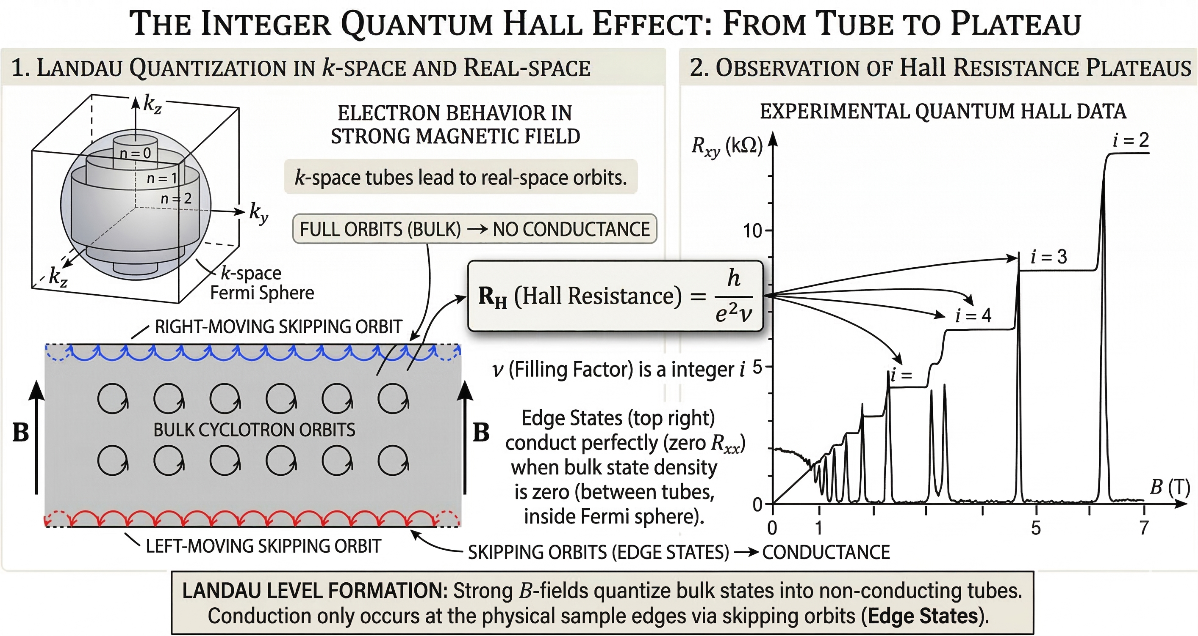
INTEGRAL QUANTUM HALL EFFECT
dhttp://www.damtp.cam.ac.uk/user/tong/qhe/qhe.pdf

Slide 13
THANK YOU

